Slide 1
VISUAL READING IN A NUTSHELL
Nesho Bonchev High School - Panagyurishte
XIIv - Science class

Slide 2
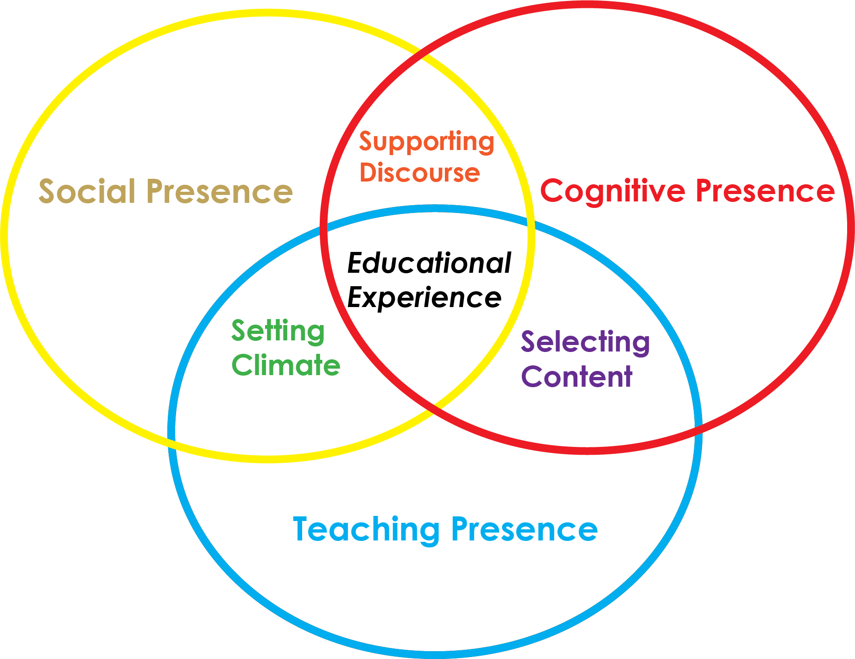
Task-based learning
Who: 12v - Science class
What: Book-trailers
Where: Virtual classroom
Why:
Main aims: Digital, Foreign language & Communication Skills
Objectives: 1. Reading books; Analyzing; Doing some research
2.21st century ‘ soft’ skills
3. Peer Assessment
Resources: Adobe Spark https://www.adobe.com/express/

Slide 3
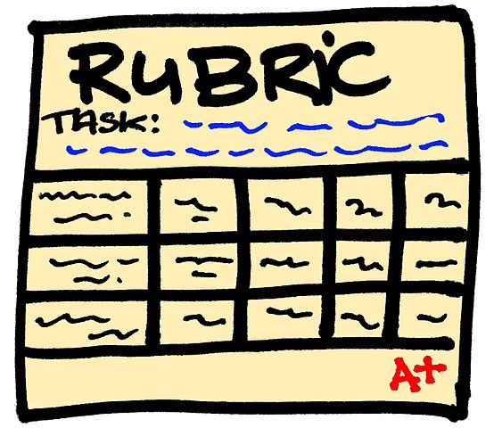
Book-trailer requirements (30 points):
- Title of the book - 2,5 points
- Author - short biography - 2,5
- Genre - 5
- Plot - the era, the atmosphere, the mood ... -5
- Setting - 5
- Main characters - description (the way they are dressed), their character - 5
- Recommendation; Resources - 5
Rubrics for English through Literature Communication – Book trailers/ e-books – 30 points

Slide 4
IT: 15-20 slides (2-3mins); appr. 6 rows-6 words per slide; enough time for reading; appropriate music, images, background
Presentation: Involving the audience; smile; fluent speaking; efficient recommendation
Clues: https://spark.adobe.com/ ; Photostage Slideshow; Filmora; Movie Maker ...etc.
Rubrics for Assessment

Slide 5
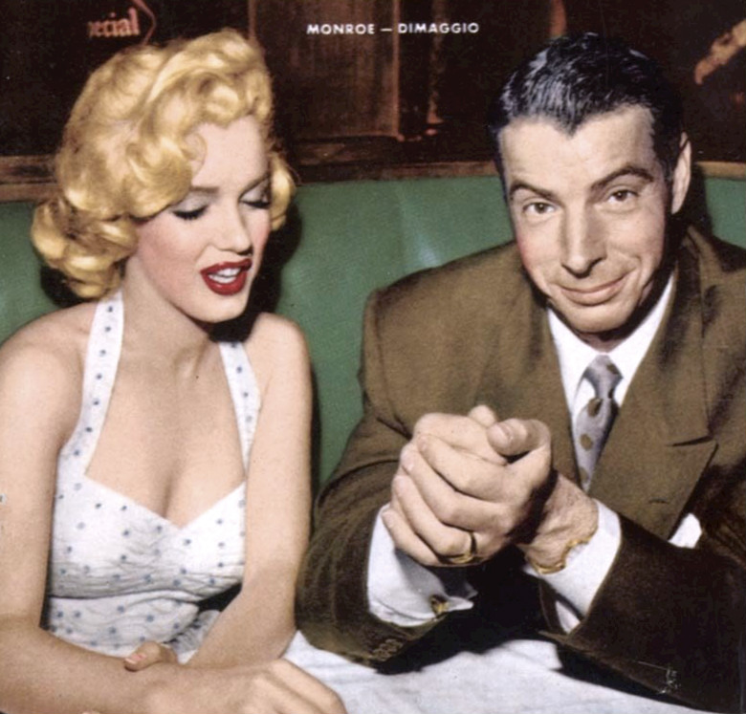
Fathers & Sons – Ernest Hemingway
The Stowaway - Julian Barnes
Maria Gurbeshlieva

Slide 6
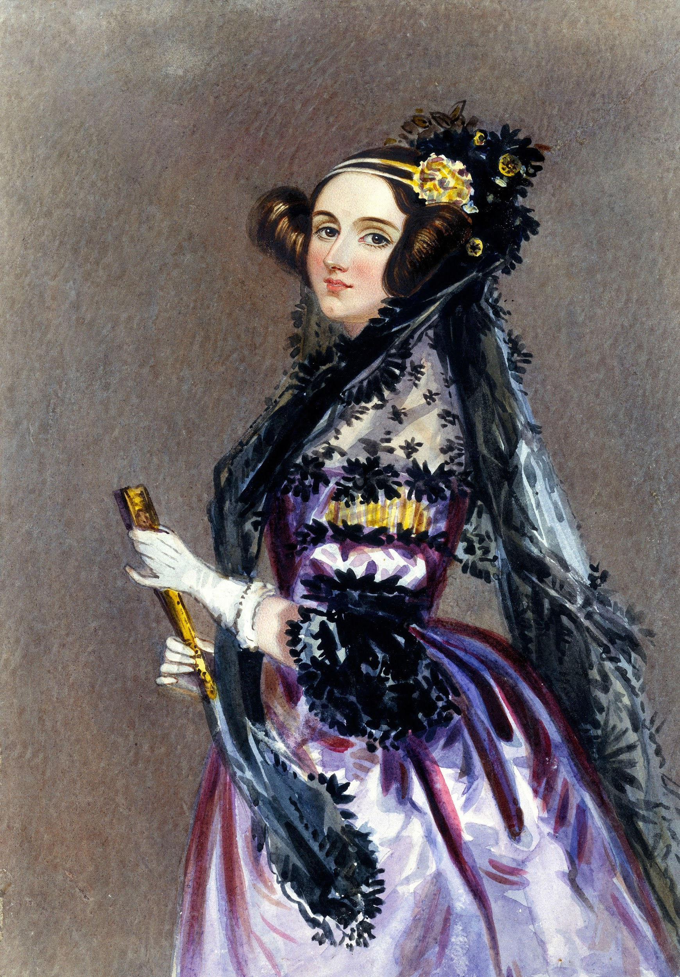
She walks in beauty - George Gordon Byron
Alexandra Maznekova

Slide 7
The Great Getsby -
F. Scott Fitzgerald
Stiliana Kirilova

Slide 8
The Rime of the ancient Mariner -
Samuel Taylor Coleridge
Iron Maiden
Bozhidar Bekyarov

Slide 9
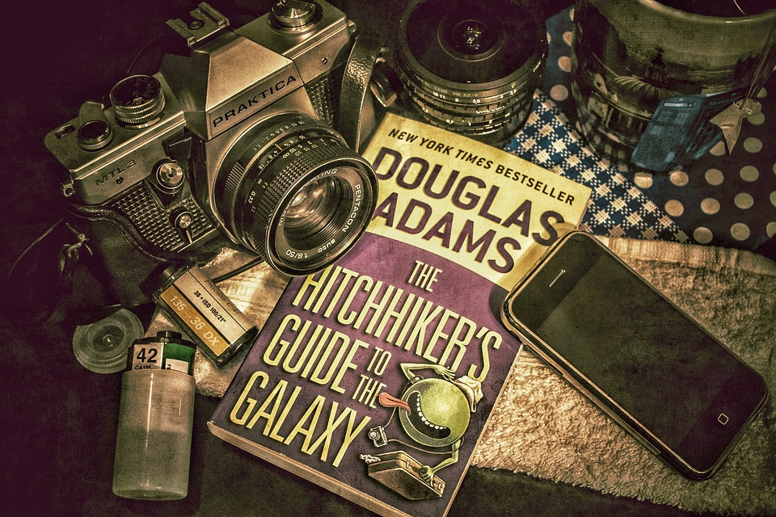
The Hitchhiker’s Guide to the Galaxy -
Douglas Adams
Ivana Panayotova

Slide 10
A Clockwork Orange -
Antony Burgess
Hristiyana Kokotanekova

Slide 11
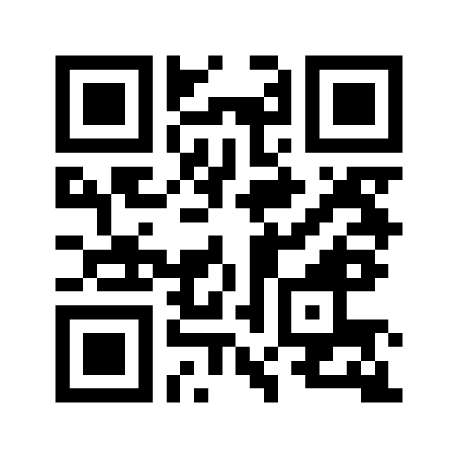
Feedback 3 - 2 - 1
https://www.menti.com/wrjfrosgx6
Notes:
https://www.mentimeter.com/s/b8b37a03bdbc4a27013725d48101ffe4/68f466792978/edit

Slide 12
Any questions?

