Slide 1
УСМИВКАТА
Най-популярната мимика

Slide 2
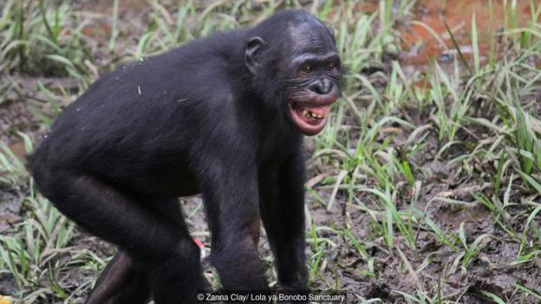

Slide 4
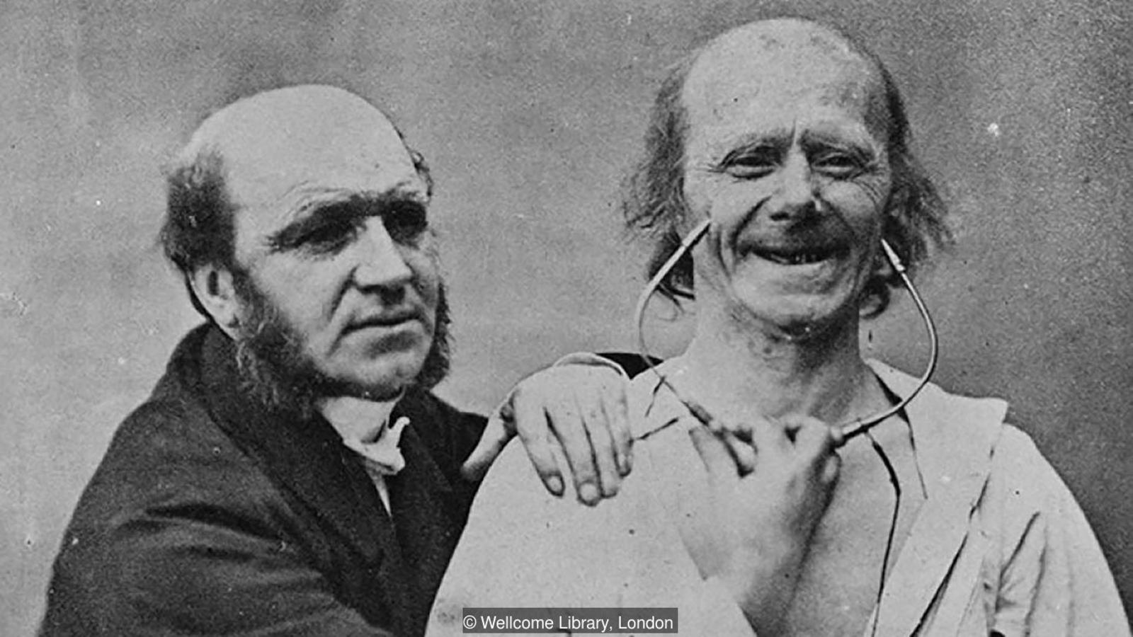

Slide 5
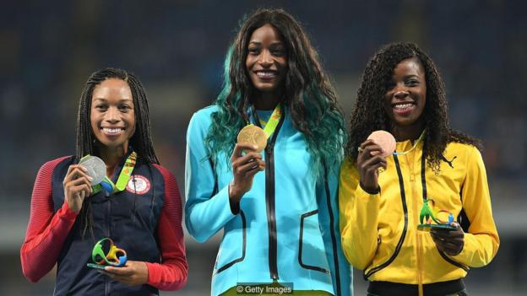

Slide 6
You can get a clear image of this smile just from its name alone: lips are closed, and teeth aren't visible. If by all means you encounter anyone smiling at you this way, trust me that he or she is hiding something! It's no wonder politicians use this one all the time... The Closed-Lip Smile

Slide 7
The lopsided smile, aka the twisted smile, is when one side of someone's mouth goes upwards, while the other side goes down. It usually represents a state of mixed emotions. While the ''down'' side might signal that a negative outcome for you is in the making, the ''up'' side cancels it out with its more positive point of view.

Slide 8
The Sneer This typical sarcastic smile is the one where corners of the mouth start going in the direction of ears, thus making so-called sneering dimples. The person who sneers rarely has respect or empathy towards anyone, so it's no surprise that it is mostly common among criminals and psychiatric patients.

Slide 9
Confident Smile You don't need an excuse to wear this one, so why not wear it all the time? Your grin will show everyone that there is no room for low self-esteem in your life!

Slide 10
The Forced Smile The most unnatural among different types of smiles, the forced smile, accompanied with full-on grin and soulless eyes, gives the feeling that the person using it isn't very interested in what you are saying. All those friendships are destroyed with this smile!

Slide 11
The Genuine Smile Enough with the moody smiles! This one is the best and most joyful of all! You don't have to work for it, it comes naturally; and when it does, you start grinning from ear to ear, your eyes start sparkling and your whole face lights up. So viva la genuine smile!

Slide 12
Open Mouth Smile Another one of different types of smiles, the open mouth smile is somewhat like a frozen laugh. It is not very good to wear on an everyday basis since it doesn't look natural, but it's great for pictures. It radiates happiness, and will make all of your selfies pop!

Slide 13
The Smug Smile Here's one you definitely know! Pressed together lips with a slightly raised side. Get the picture? And while being one of the most favorite smiles to wear, it also has a wide range of meanings. It could be a sign of arrogance, satisfaction, and could even be used while flirting.

Slide 14
Flirtatious Smile This one is similar to the smug smile, and as the name says, its prime role is flirting. It is considered to be incredibly mysterious, sexy and inviting, particularly in women who tend to make it even more attractive by biting and licking their lips.

Slide 15
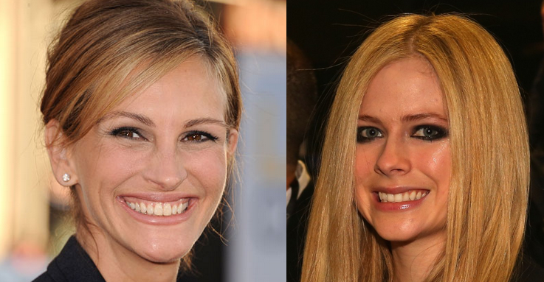

Slide 16
Naughty Or Up-to-No-Good Smile You know when you get caught doing something you shouldn't have done? Yup, this is how you smile then.

Slide 17
The Sleepy Smile

