Slide 1
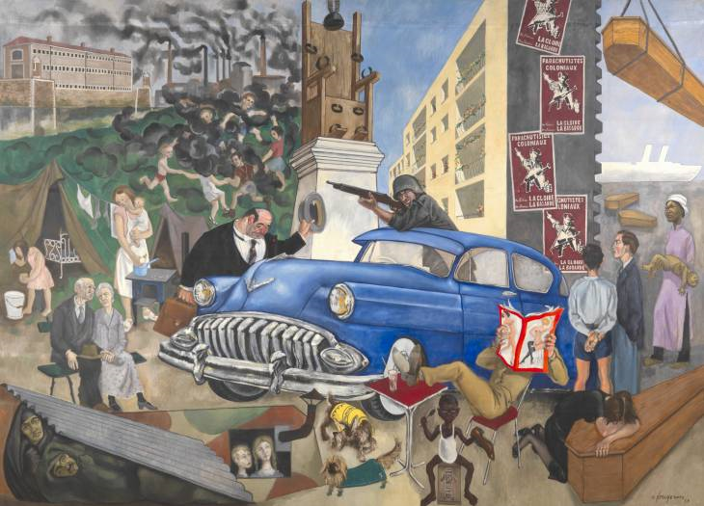
Civilisation of the 20-th century
History and civilisation – 11 grade

Slide 2
Any ideas …..what is a civilisation?

Slide 3
The accomplishments of the civilisation?
P.10/ source 1
What do you think?
Do you agree?
Any civilisation around you?

Slide 4
1. The Term
Technology
Family life
Religion
Value system
Culture

Slide 5
2. Specific Characteristics
Developed system of productivity;
Political and cultural collaboration;
Spiritual development.
Are they interconnected or they can work indеpendently?

Slide 6
3. The Second Industrial Revolution
Scientific researches;
New productions and new technique
Modern Industries – p. 13 – Chart

Slide 7
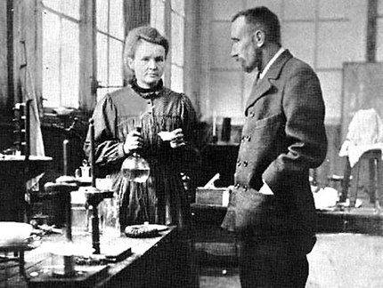
Materials | Results
Electricity | Metallurgy, machine building
Technologies for working with Petrol | Chemistry, Cosmetics, Pharmacists
Machine building
Automobile building
Aircraft building
Researches

Slide 8
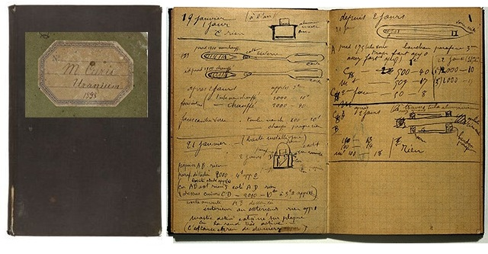
USA, England, Russia, France, Italy – the most developed countries
Big industrial centres
Urbanisation
Mega cities
What are the consequences of the this?

Slide 9
4. The Modern Civilisation and the Man
New tendencies and new ways
New changes – in mind, in thinking, in behaviour
Fashion tendencies
New hobbies
New morals and values
“New Athens”
Ecology

Slide 10
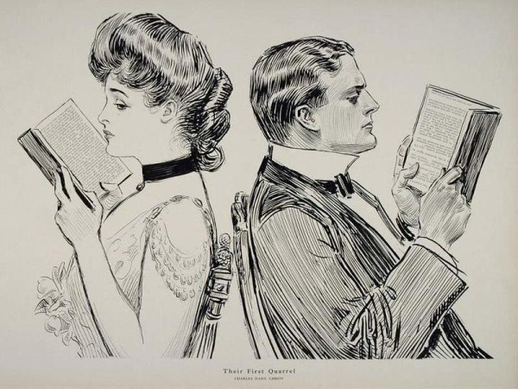

Slide 11
New ideas for countries
- The Countries of abundance,
- The Countries of Prosperity and Welfare

Slide 12
Homework
Може ли индивидът да постигне индивидуална самоличност в урбанизираното общество?

