Slide 1
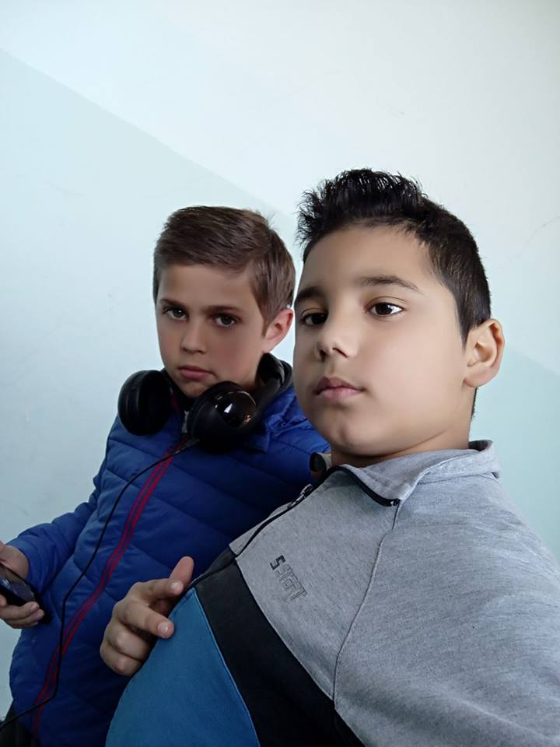
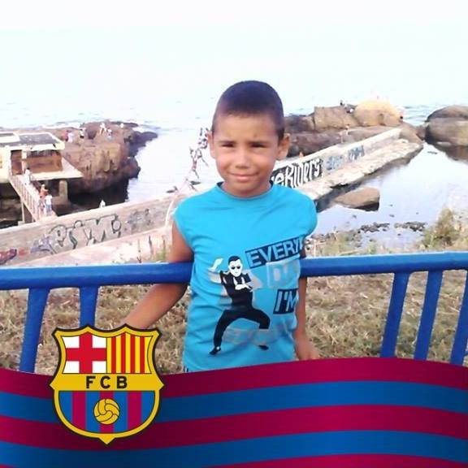
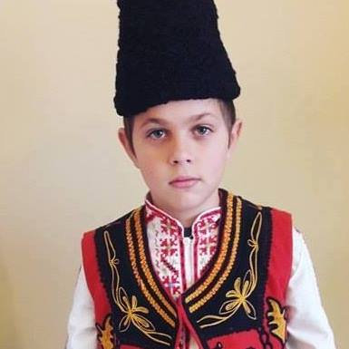
English lesson
Names:
Hristo Stratiev Genev
And
Kevin Marianov Mutafchiev

Slide 2
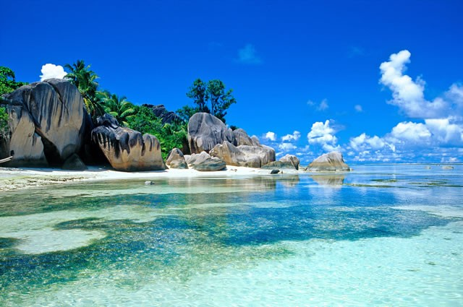
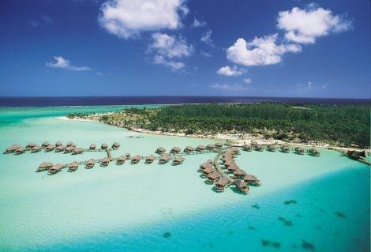
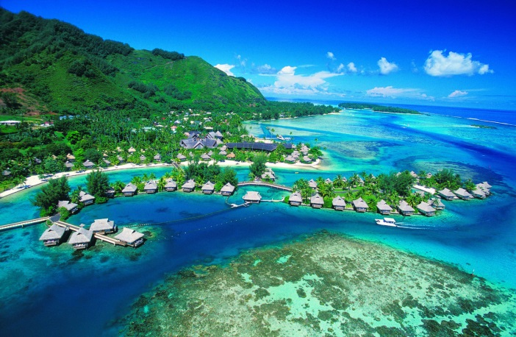
Wanda and Wiz 1 part
Last month Wanda and Wiz went to a Pacific island . It was very hot.

Slide 3
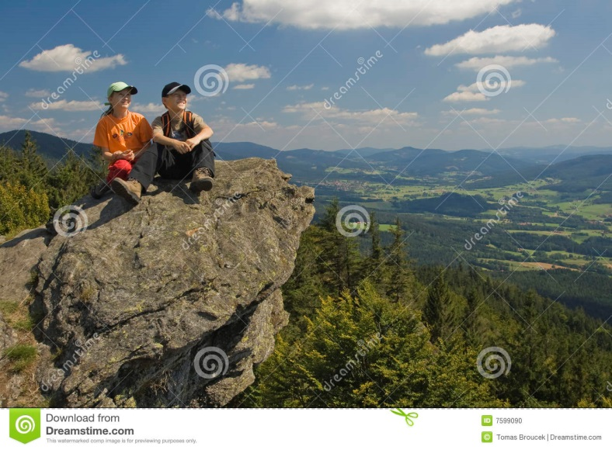
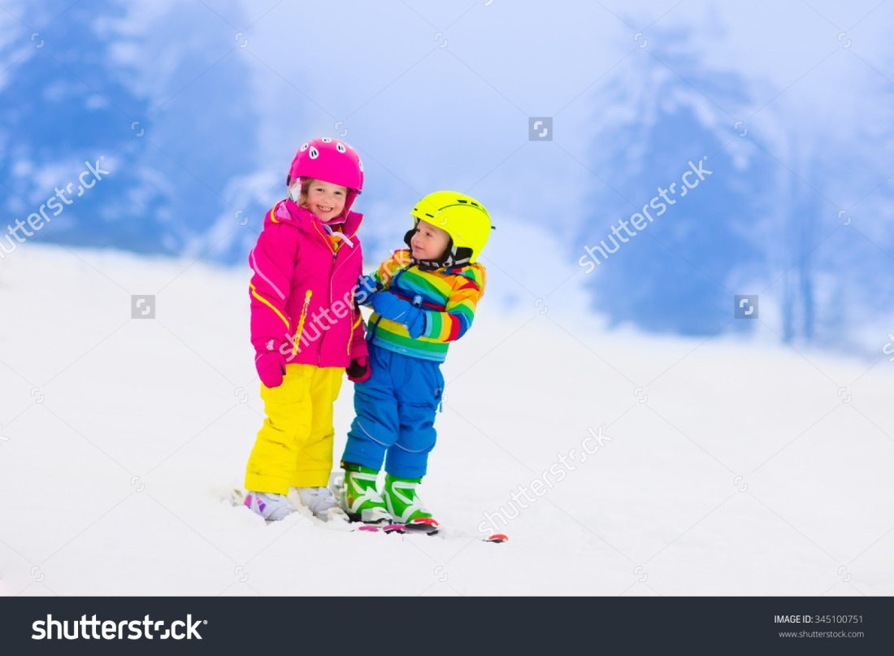
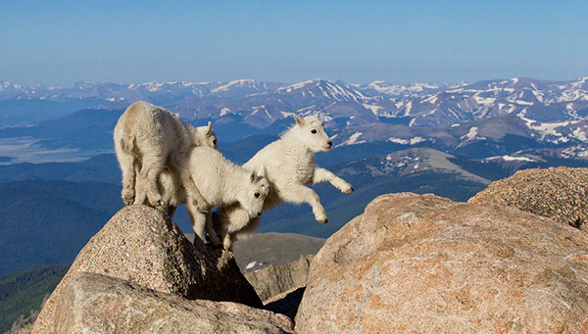
Wanda and Wiz part:2
They climbed a very high mountain.

Slide 4
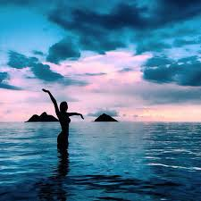
They saw the ocean
=

Slide 5
Wanda showed Wiz a map

Slide 6
They went home by plane

