Slide 1
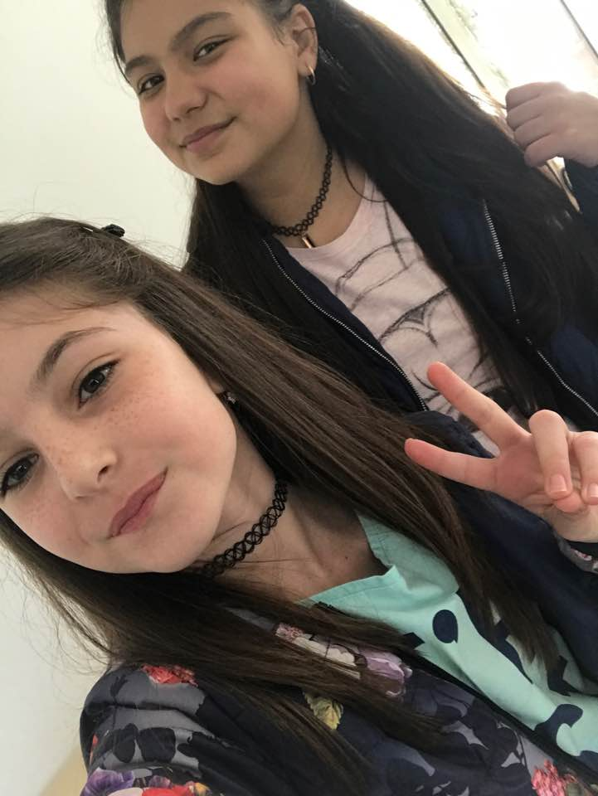
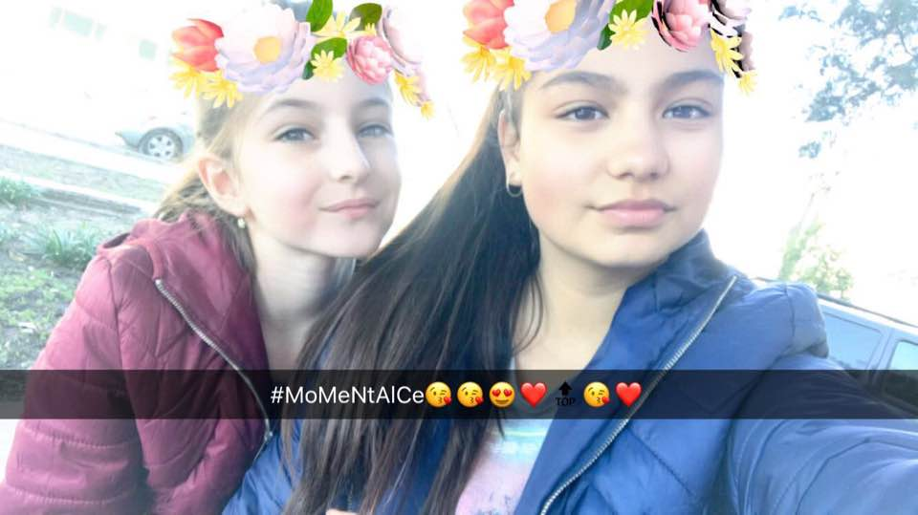
English lesson
Tedi and Krisi

Slide 2
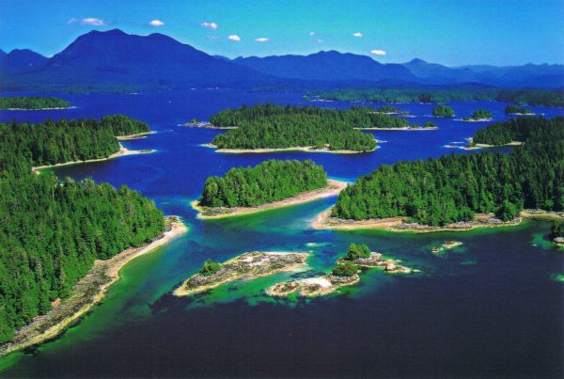
Last month Wanda and Wiz went to a Pacific island. It was very hot.

Slide 3
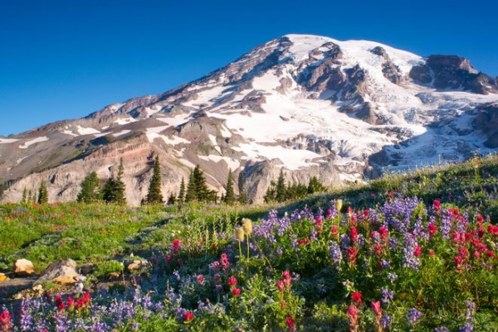
They climbed a very high mountain.

Slide 4
They saw the ocean.

Slide 5
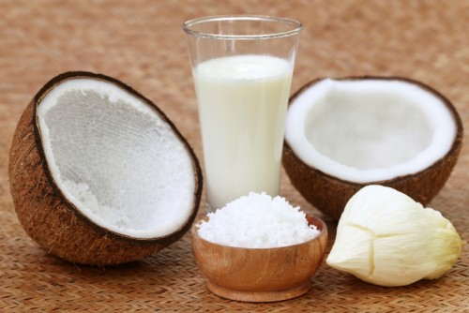
They drank coconut milk.

Slide 6
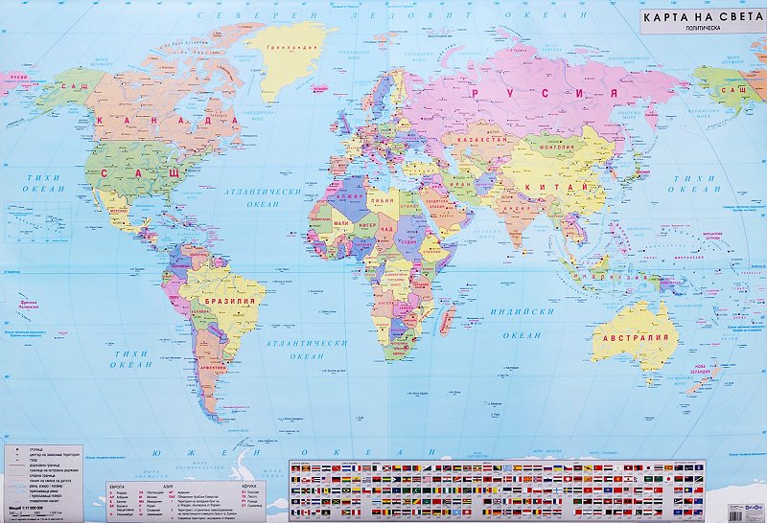
Wanda showed Wiz a map.

Slide 7
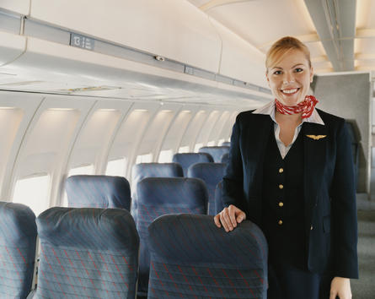
They went home by plane.

