Slide 1
„Новите предизвикателства в професията на началния учител“ №216 -1-BG01-КА101-023065 Ключова дейност 1, “Образователна мобилност за граждани“,сектор «Училищно образование»
Начално училище «Отец Паисий»
гр. Харманли

Slide 2
1. Petya Petrova Dimova ICT for teaching 2. Galina Atanasova Hristozova English Methodology 21st century
1-12 August, 2016 at Centre of English Studies/CES/
Leeds, UK

Slide 3
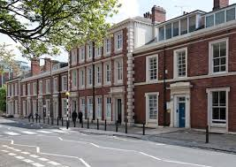
.
Centre of English Studies/CES/
Leeds, UK
English Matters is an educational center with headquarters in Madrid. It offers courses in English and ICT for students and teachers in England, Ireland, Spain, Finland and Germany. It works with schools on Erasmus+.

Slide 4
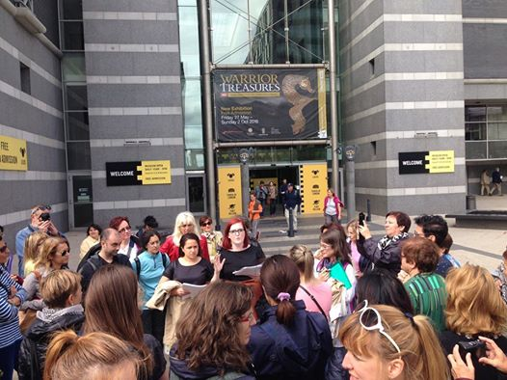
We visited different sites in Leeds and went on trips outside Leeds. Our experience and all the photos and materials we gathered will be used during our lessons at school by making different tasks and projects for our students.
In the afternoons teachers did some field projects under the guidance of teachers from CES.

Slide 5
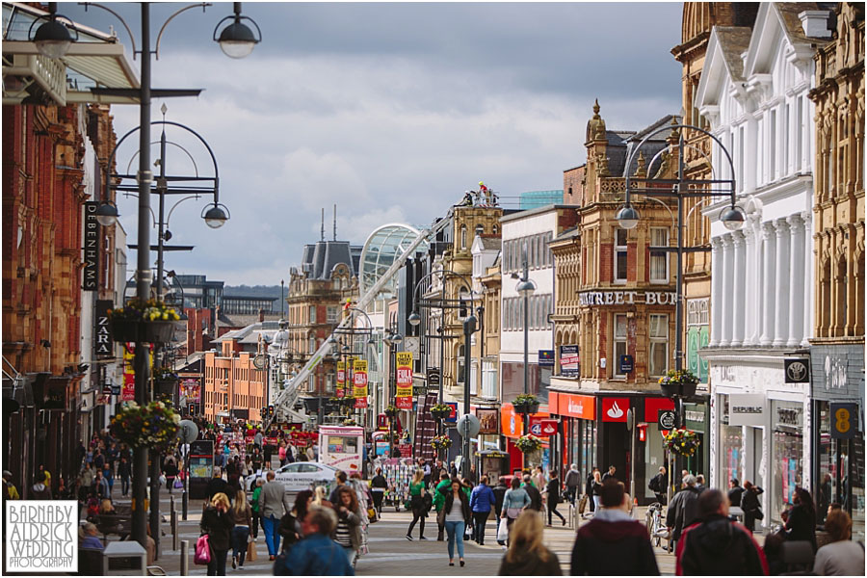
Leeds is located in the county of West Yorkshire and it is the largest city there with population of 440 00 people.
Leeds is 310 km west of London, 100 km away from Liverpool and 60 km south of Manchester.
The river Eyre runs through Leeds and the hottest months are July and August when the average t ° is around 19-20 ° .
The University of Leeds is a very prestigious one and was founded in 1904.

Slide 6
Field Project: The Royal Armouries Museum
Our visit
Outside the museum

Slide 7
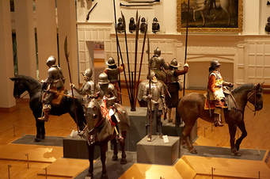
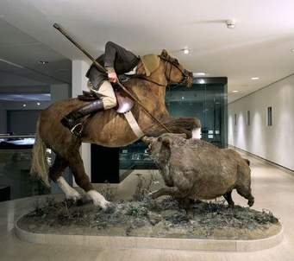
The interior of the National Armoury Museum is divided into several galleries: The War Gallery, Peace-a Farewell to Arms, Tournament Gallery, Oriental Gallery, Self Defence and Hunting Gallery.

Slide 8
Answer the questions:
How many galleries are there in the museum?
2. What can you see in the Hunting gallery?
3. Which gallery would you like to visit?

Slide 9
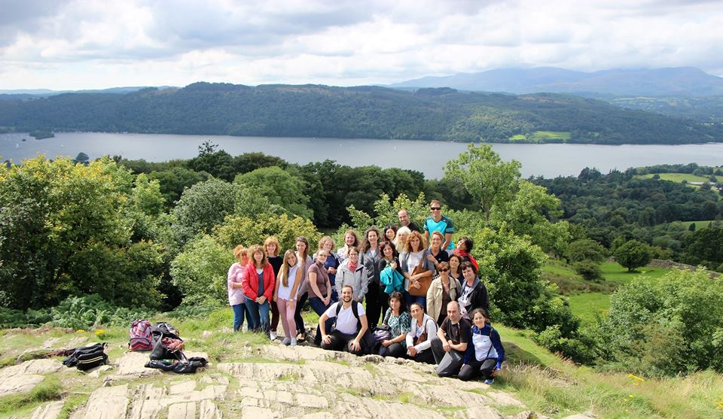
Field Project: Windermare, the Lake District.

Slide 10
Windermere is the largest natural lake in England.
Bowness-on Windermere –is an excellent centre for boating activities and climbing up the hills.

Slide 11
After visiting the recommended link /Bowness-on Windermere/ answer the questions:
1. What nature can you see in these area?
2. How can you enjoy the beauties of nature:
-walking
-what else?
Bowness-on Windermere

Slide 12
Field Project: Leeds City Museum
.
.

Slide 13
exhibits vary but they are mainly made up of exhibits from Leeds' history.

Slide 14
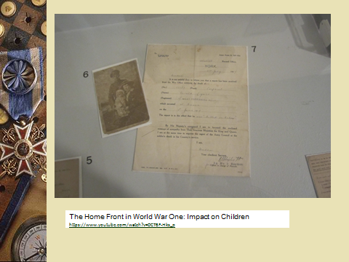

Slide 15
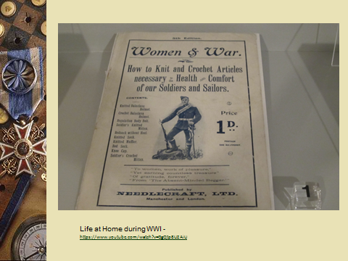

Slide 16
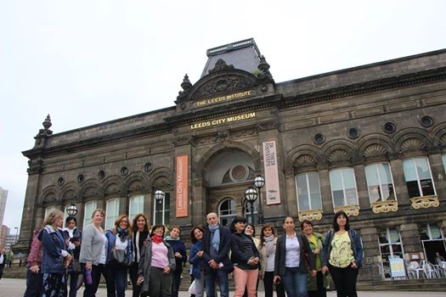
https://youtu.be/PF7x0Xgpcrg 1. Make a virtual tour in Leeds Museum 2. Discuss what you have seen during the video
.

Slide 17
Field Project: Henry Moore Institute
Sclupture and Prosthetics
Research Library and Archive

Slide 18
=
The Henry Moore Institute is a world-recognised centre for the study of sculpture.

Slide 19
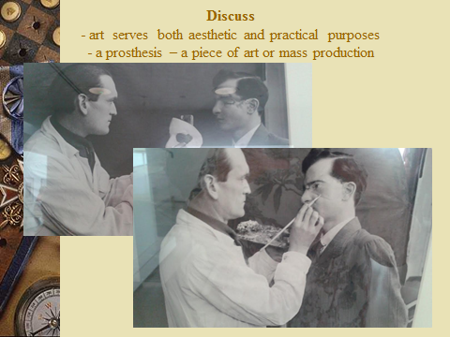
1. Language development tasks on architecture and art 2. “Text attack” reading task

