Slide 1
William Somerset Maugham
1874 –1965

Slide 2
a British playwright
a novelist
a short story writer
one of the most popular writers of his era and reputedly the highest paid author during the 1930s.

Slide 4
Born in Paris, France.
His father - a lawyer who handled the legal affairs of the British embassy in Paris.
Qualifications - a physician.
The initial run of his first novel, Liza of Lambeth (1897), sold out so rapidly that Maugham gave up medicine to write full-time.

Slide 5
Mother – died of tuberculosis when S. Maugham was 8. His father died 2 years later of cancer.
His uncle (a vicar) took care of him; cold and emotionally cruel
French – S. Maugham’s 1st language; teased for his bad English while he studied in England; developed a stammer; shy, introverted

Slide 6
In Germany he studied literature, philosophy and German at Heidelberg University;
Writing steadily since the age of 15 and fervently wished to become an author;
Maugham dropped medicine and embarked on his 65-year career as a man of letters. He later said, "I took to it as a duck takes to water."

Slide 7
The writer's life allowed Maugham to travel and to live in places such as Spain and Capri.
During World War I he worked as a secret agent. After the war he travelled in India and Southeast Asia; all of these experiences were reflected in later short stories and novels. In 1928 he bought a villa in the south of France, which became his permanent home.

Slide 8
Maugham, by then in his sixties, spent most of the Second World War in the United States, first in Hollywood and then in the south.
After his companion Gerald Haxton died in 1944, Maugham moved back to England. In 1946 he returned to his villa in France, where he lived, interrupted by frequent and long travels, until his death.

Slide 9
Although homosexual, Maugham married and had a daughter.
The marriage was unhappy, though, and his wife divorced him, finding his relationship and travels with Haxton too difficult to live with.

Slide 10
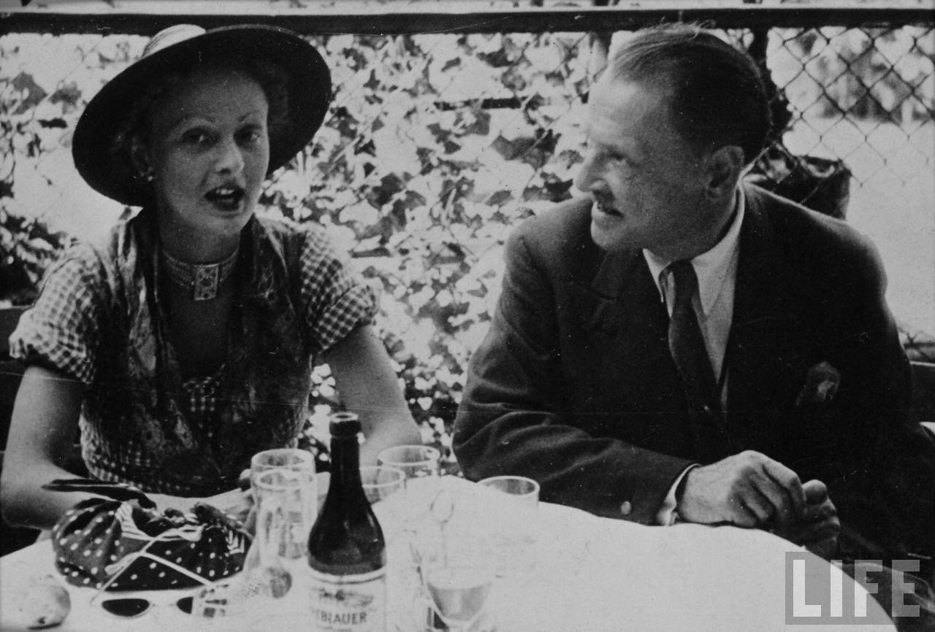

Slide 11
His first novel - Liza of Lambeth - a tale of working-class adultery and its consequences. It drew its details from Maugham's experiences as a medical student doing midwifery work in Lambeth, a South London slum.

Slide 13
Significant works
Maugham's masterpiece,
Of Human Bondage, a semi-autobiographical novel, describing his unhappiness and anxiety in early life and recounting his experiences as a medical student.

Slide 14
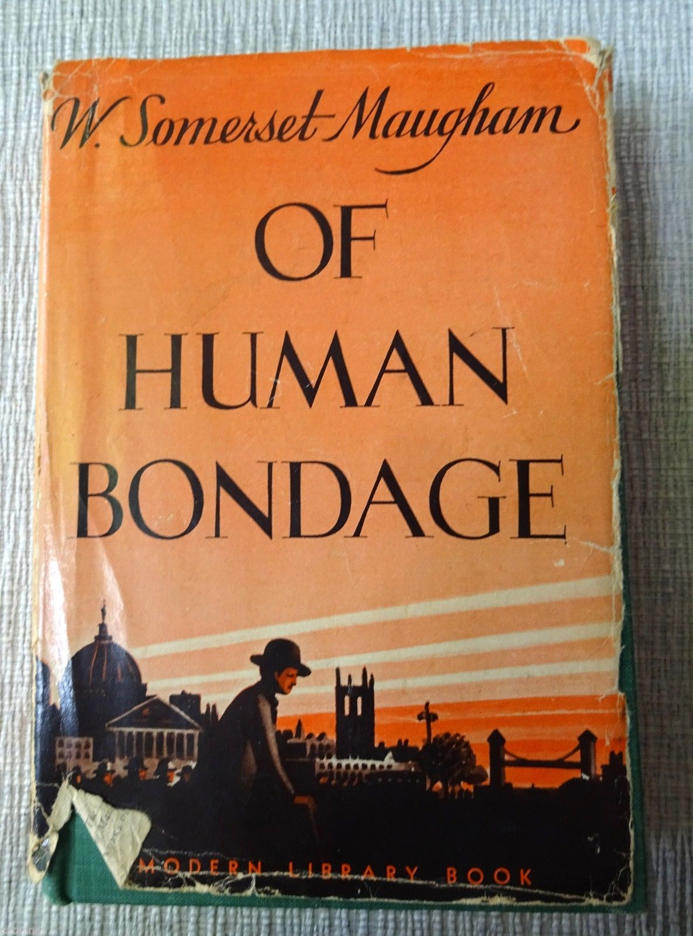

Slide 15
Maugham indicates in his foreword that he derived the title from a passage in Baruch Spinoza's Ethics:
"The impotence of man to govern or restrain the emotions I call bondage, for a man who is under their control is not his own master…”

Slide 16
The close relationship between fictional and non-fictional became Maugham's trademark.
"Fact and fiction are so intermingled in my work that now, looking back on it, I can hardly distinguish one from the other."

Slide 17
Two of his later novels were based on historical people: The Moon and Sixpence is based on the life of Paul Gauguin, the artist who rejected France and civilization to live in Tahiti; and Cakes and Ale contains unflattering characterizations of the authors Thomas Hardy (Tess of the d'Urbervilles) and Hugh Walpole (Mr Perrin and Mr Traill)

Slide 18
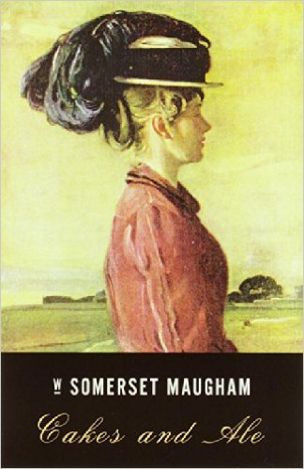

Slide 19
In 1916, Maugham travelled to the Pacific to research his novel The Moon and Sixpence.
He became known as a writer who portrayed the last days of colonialism in India, Southeast Asia, China and the Pacific.

Slide 20
British Empire at its territorial peak in 1921

Slide 21
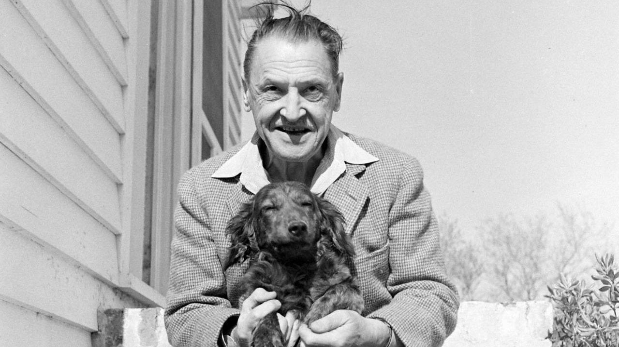
Maugham became a witty satirist of the post-colonial world and wrote over thirty plays, mainly light satiric comedies.

Slide 22
List of S. Maugham’s popular works
Liza of Lambeth – Лайза от Ламбет
Mrs Craddock – Госпожа Крадък
The Magician
Of Human Bondage – Души в окови
The Moon and Sixpence – Луна и грош
The Painted Veil – Цветният воал
Ashenden: Or the British Agent - Ашендън
Cakes and Ale: or, the Skeleton in the Cupboard – Вино и баници или скелет в гардероба
The Narrow Corner – Натясно в ъгъла (Невъзможно бягство)
The Razor's Edge - Острието на бръснача

Slide 23
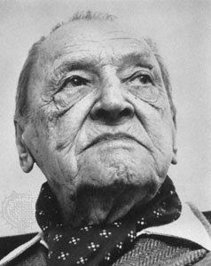
Today, Maugham is probably best known as a short story writer. His clear, lucid and economical style makes easy reading.

Slide 24
The Moon and Sixpence Plot summary
It is told by a first-person narrator, in a series of glimpses into the mind and soul of the central character Charles Strickland, a middle-aged English stockbroker, who abandons his wife and children abruptly to pursue his desire to become an artist. The story is in part based on the life of the painter Paul Gauguin.

Slide 25
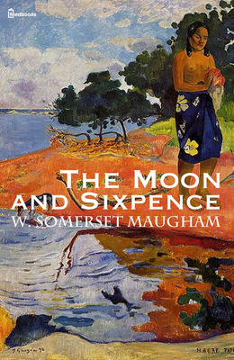
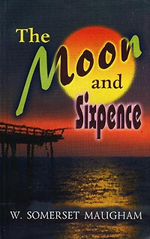

Slide 26
Early in the novel, he leaves his wife and children and goes to Paris. He lives a destitute but content life there as an artist;
Strickland, in his drive to express himself through art, cares nothing for physical discomfort and is indifferent to his surroundings.

Slide 27
After the Paris episode, the story continues in Tahiti. Strickland has already died, and the narrator attempts to piece together his life there from recollections of others. He finds that Strickland had taken up a native woman, had two children by her and started painting profusely. He finally died of leprosy, leaving behind numerous paintings, but his magnum opus, which he painted on the walls of his hut before losing his sight to leprosy, was burnt after his death by his wife per his dying orders.

Slide 28
A Tahitian woman by Paul Gauguin

Slide 29
Tahiti is the highest and largest island in French Polynesia

Slide 30
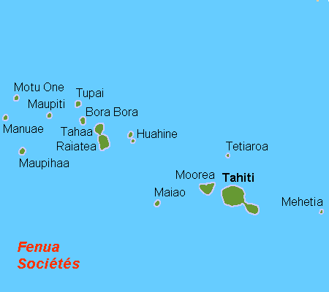
The island is located in the archipelago of the Society Islands in the central Southern Pacific Ocean.

Slide 31
Tahiti

Slide 32
Tahiti

Slide 33
The island was formed from volcanic activity and is high and mountainous with surrounding coral reefs.

Slide 34
Tahiti was originally settled by Polynesians.

Slide 35
A Tahitian woman in a traditional costume

Slide 36
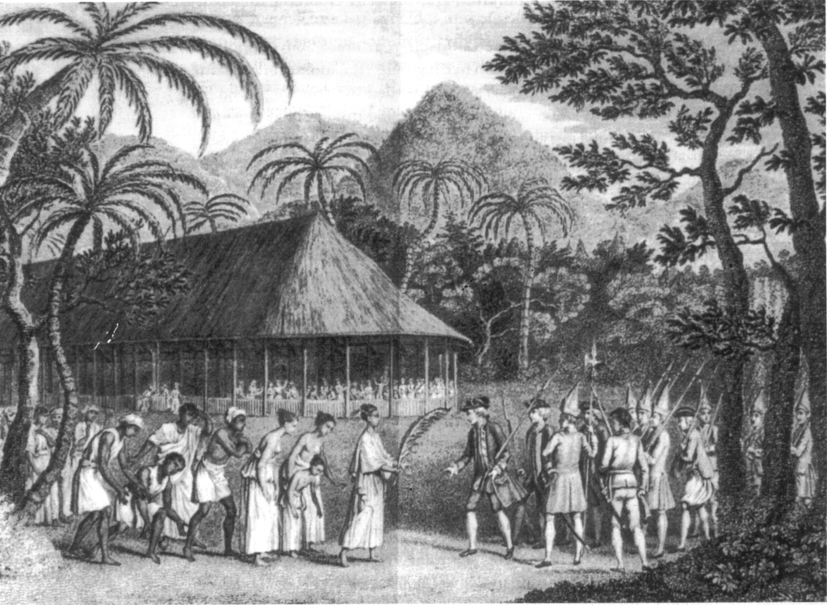
The island was part of the Kingdom of Tahiti until its annexation by France in 1880, when it was proclaimed a colony of France.

Slide 37
According to some sources, the title, the meaning of which is not explicitly revealed in the book, was taken from a review of Of Human Bondage in which the novel's protagonist, Philip Carey, is described as "so busy yearning for the moon that he never saw the sixpence at his feet." According to a 1956 letter from Maugham, "If you look on the ground in search of a sixpence, you don't look up, and so miss the moon."

Slide 40
The choice is yours

