Slide 1
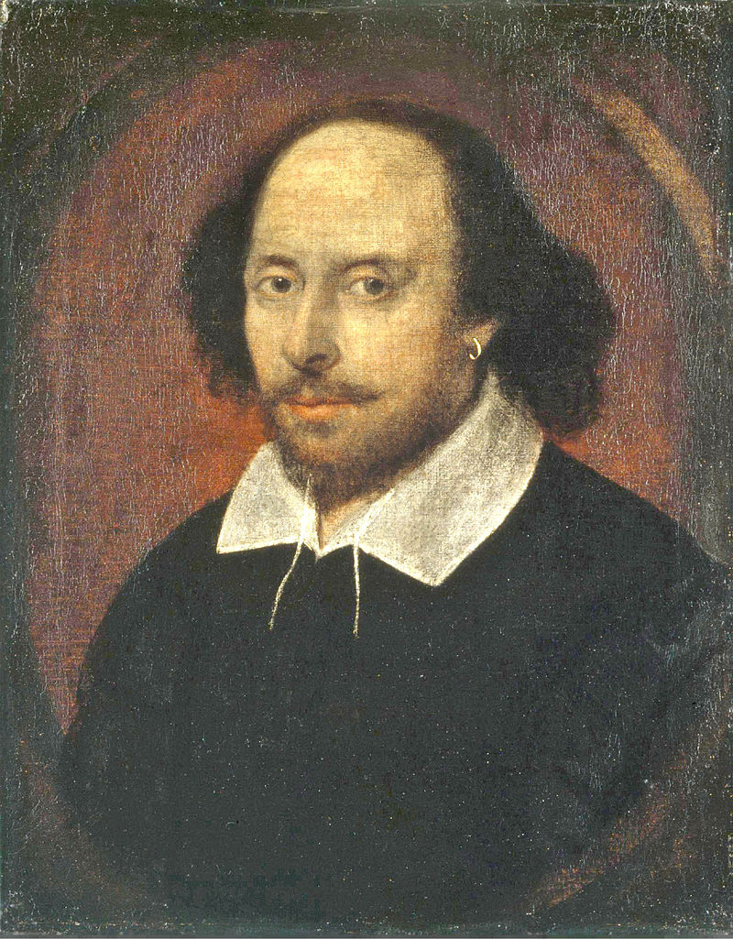
William Shakespeare
1564-1616

Slide 2
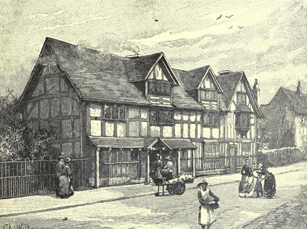
William Shakespeare
William Shakespeare was an English poet, playwright, and actor. He was born on 26 April 1564 in Stratford-upon-Avon. His father was a successful local businessman and his mother was the daughter of a landowner. Shakespeare is widely regarded as the greatest writer in the English language and the world's pre-eminent dramatist. He is often called England's national poet and nicknamed the Bard of Avon.
John Shakespeare's house, believed to be Shakespeare's birthplace, in Stratford-upon-Avon.

Slide 3
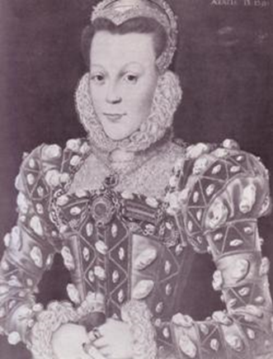
Shakespeare’s parents
John Shakespeare
(1531 -1601)
Mary Arden
(1537-1608)

Slide 4
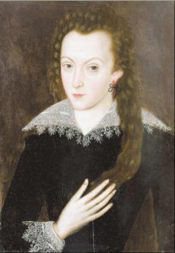
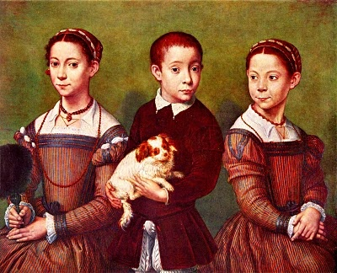
Shakespeare’s family
Shakespeare married Anne Hathaway at the age of 18. She was eight years older than him. They had three children: Susanna, and twins Hamnet and Judith. After his marriage information about his life became very rare.
Anne Hathaway, Shakespeare’s wife
Susanna, Hamnet and Judith, Shakespeare’s children

Slide 5
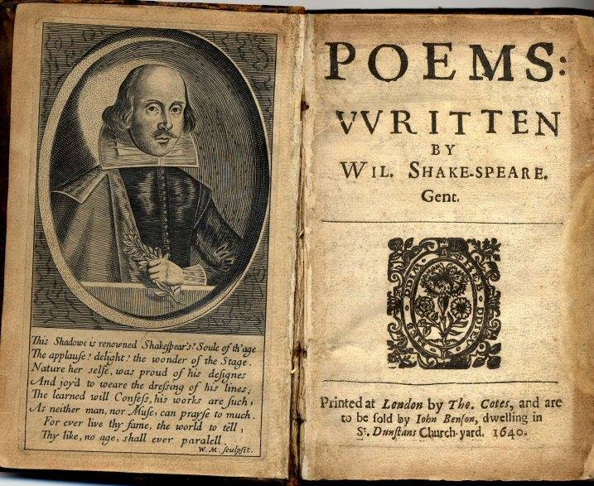
London and theatrical career
Shakespeare spent most of his time in London writing and performing in his plays. Between 1585 and 1592, he began a successful career in London as an actor, writer, and part-owner of a playing company called the Lord Chamberlain's Men, later known as the King's Men.

Slide 6
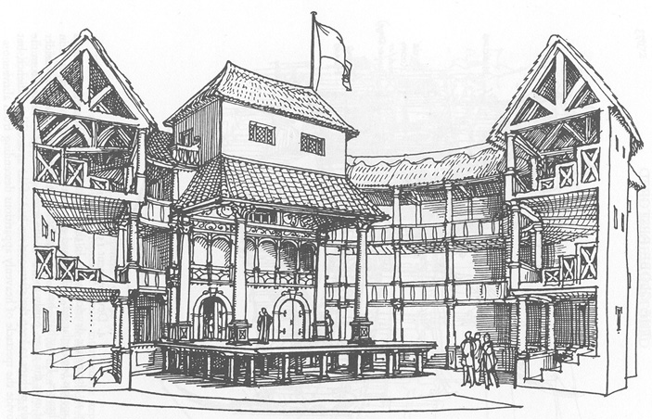
The Globe Theatre
The Globe Theatre was a theatre in London associated with William Shakespeare. It was built in 1599 by Shakespeare's playing company, the Lord Chamberlain's Men. It was destroyed by fire on 29 June 1613. A second Globe Theatre was built on the same site by June 1614 and closed in 1642. A modern reconstruction of the Globe was named "Shakespeare's Globe”. Shakespeare's Globe is the complex housing a reconstruction of the Globe Theatre, an Elizabethan playhouse in the London Borough of Southwark.

Slide 7
Divisions of Shakespeare’s plays
Procession of Characters from Shakespeare's Plays
Phase 1
From the late 1580s to 1594, Shakespeare experimented with different kinds of comedy in Love’s Labour’s Lost, The Comedy of Errors, Two Gentlemen of Verona, and The Taming of the Shrew. He began to explore English history in his first `tetralogy’ (a linked sequence of four plays) comprising Henry VI (in 3 parts) with Richard III. Titus Andronicus was his first tragedy.
Phase 2
From 1594 to 1599 Shakespeare continued to concentrate on comedies and histories. The comedies of this period ö A Midsummer Night’s Dream, The Merry Wives of Windsor, The Merchant of Venice, As You Like It, and Much Ado About Nothing ö are mainly in his best-loved `romantic’ vein, while his fuller command of histories appears in the second tetralogy: Richard II, Henry IV (2 parts), and Henry V. This second period also includes the historical King John and a sentimental tragedy, Romeo and Juliet.

Slide 8
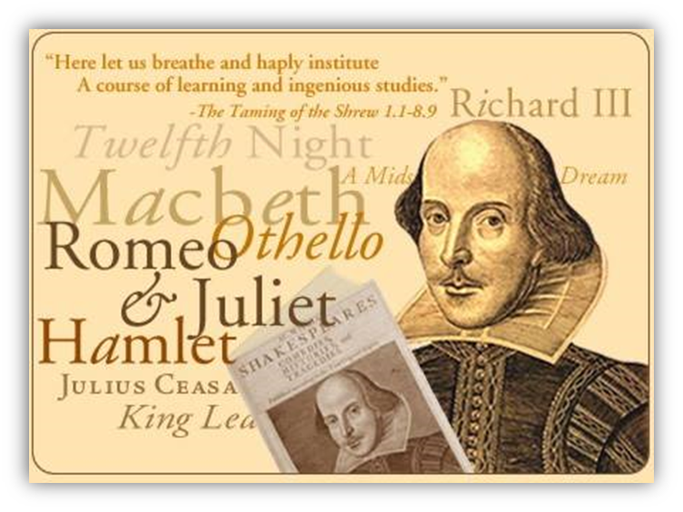
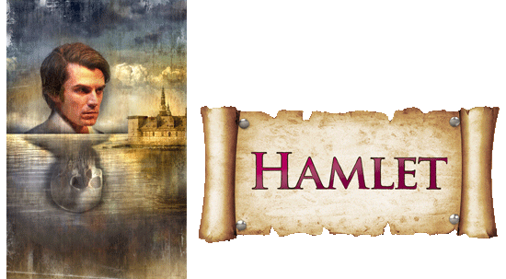
Phase 3
In the third period, from 1599 to 1608, Shakespeare abandoned romantic Comedy (except for Twelfth Night) and English history, working instead on tragedies and on the disturbing ‘dark’ comedies or `problem plays’ Measure for Measure, All’s Well that Ends Well, and Troilus and Cressida. The tragedies usually regarded as the four greatest are King Lear, Macbeth, Hamlet, and Othello, although a second group of tragic `Roman plays’ includes the equally powerful Antony and Cleopatra, along with Julius Caesar and Coriolanus. To this period also belongs the tragedy Timon of Athens, possibly written with Middleton.

Slide 9
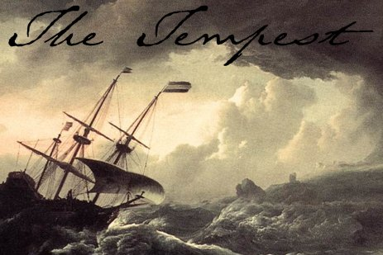
Phase 4
Shakespeare’s final phase, from 1608 to 1613, is dominated by a new style of comedy on themes of loss and reconciliation: Pericles, Cymbeline, The Winter’s Tale, and The Tempest are known as his late `romances’. Shakespeare seems to have interrupted his retirement in 1613 to collaborate with John Fletcher in Henry VIII and The Two Noble Kinsmen. Most of the fictional stories in Shakespeare’s plays were adapted from earlier plays and romances, while his historical dramas are derived from Plutarch’s biographies of Roman statesmen and from Holinshed’s rather slanted account of English history, the Chronicles (1577).

Slide 10
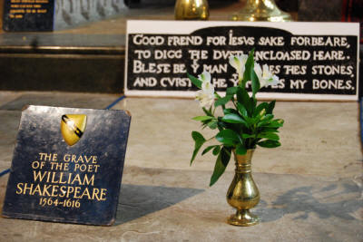
Retirement and death
Around 1613, at the age of 49, he retired to Stratford , where he died three years later. Few records of Shakespeare's private life survive. He died on 23 April 1616, at the age of 52. He died within a month of signing his will, a document which he begins by describing himself as being in "perfect health". In his will, Shakespeare left the bulk of his large estate to his elder daughter Susanna.
Shakespeare's grave, next to those of Anne Shakespeare, his wife, and Thomas Nash, the husband of his granddaughter.

Slide 11
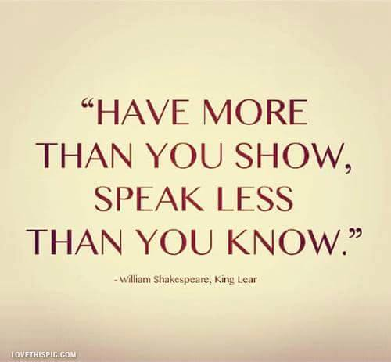
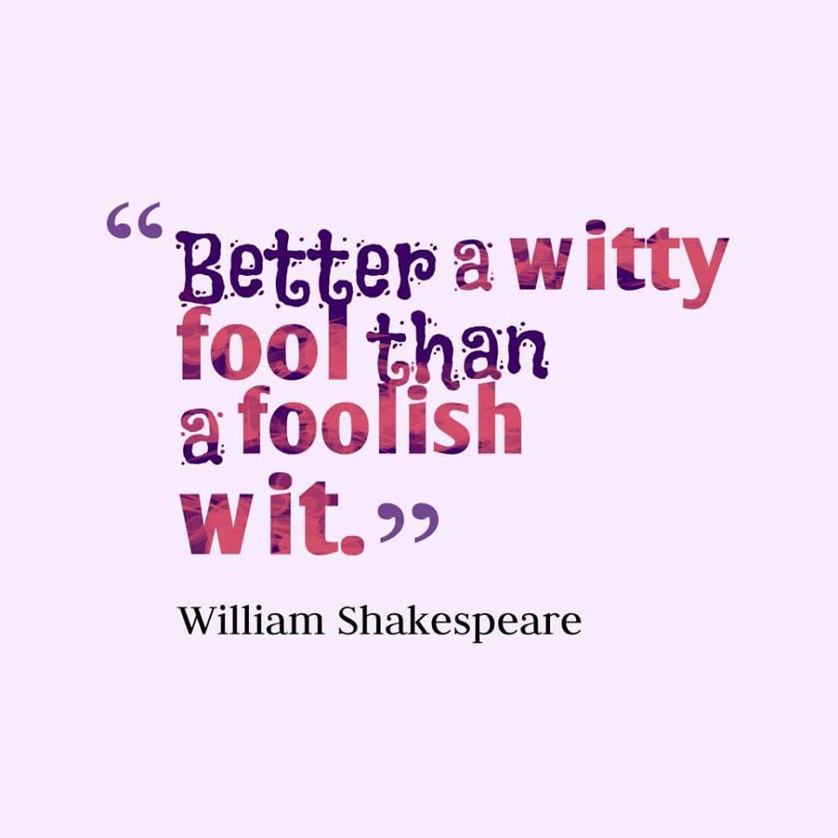

Slide 12
Interesting facts
There are more than 80 variations recorded for the spelling of Shakespeare’s name. In the few original signatures that have survived, Shakespeare spelt his name “Willm Shaksp,” “William Shakespe,” “Wm Shakspe,” “William Shakspere,” ”Willm Shakspere,” and “William Shakspeare”. There are no records of him ever having spelt it “William Shakespeare”, as we know him today.
Shakespeare lived a double life. By the seventeenth century he had become a famous playwright in London but in hishometown of Stratford, where his wife and children were, and which he visited frequently, he was a well known and highly respected businessman and property owner.
Shakespeare has been credited by the Oxford English Dictionary with introducing almost 3,000 words to the English language. Estimations of his vocabulary range from 17,000 to a dizzying 29,000 words – at least double the number of words used by the average conversationalist.

Slide 13
The Comedy of Errors is Shakespeare’s shortest play at just 1,770 lines long.
There are only two Shakespeare plays written entirely in verse: they are Richard II and King John. Many of the plays have half of the text in prose.
Shakespeare never actually published any of his plays. They are known today only because two of his fellow actors – John Hemminges and Henry Condell – recorded and published 36 of them posthumously under the name ‘The First Folio’, which is the source of all Shakespeare books published.
According to the Oxford Dictionary of Quotations, Shakespeare wrote close to a tenth of the most quoted lines ever written or spoken in English. What’s more, according to the Literature Encyclopaedia, Shakespeare is the second most quoted English writer after the writers of the Bible.

