Slide 1
project ID:2016-1-BG01-KA219-023713–ERASMUS+
Combatting discrimination and bullying
2016-2018
Seminar at Vidin, Bulgaria
1.06.2018

Slide 2
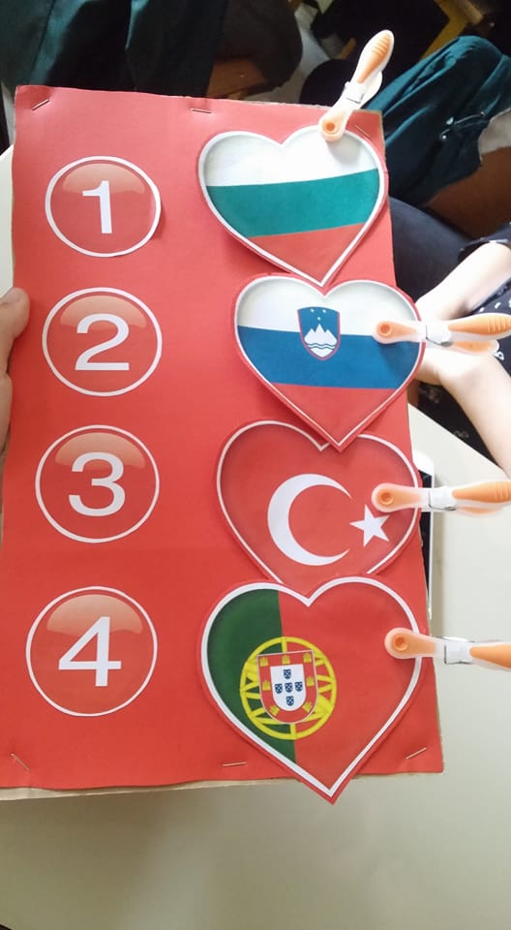
Participant countries
Bulgaria – Gimnaziya s prepodavane na tchuzhdi ezitsi “Yordan Radichkov” - Vidin
Portugal – Agrupamento de Escolas Alcaides de Faria – Barcelos
Slovenia – School Centre Srecka Kosovela Sezana - Sezana
Turkey- Serik Yunus Emre Anatolian High School-Antalya

Slide 3
Goals of The Project
1. to promote inter-cultural dialogue between different countries and socio-cultural categories
2. to reduce violence, school dropout and inequality by promoting values such as tolerance, acceptance of alterity and inter- and intra-cultural respect
3. to actively involve students in activities that presuppose working in multicultural teams
4. to discourage the tendency to stereotyping and prejudice based on isolated cases of misbehavior
5. to enhance the quality of the relationship among students of different cultural backgrounds and develop their social and communication skills
6. to encourage the learning of different languages and cultures from the European space

Slide 4
Timetable of LTTAs
(Learning Teaching Training Activity )
Portugal
Turkey
October-2017
February-2017
May-2017
March-2018
Slovenia
Bulgaria

Slide 5
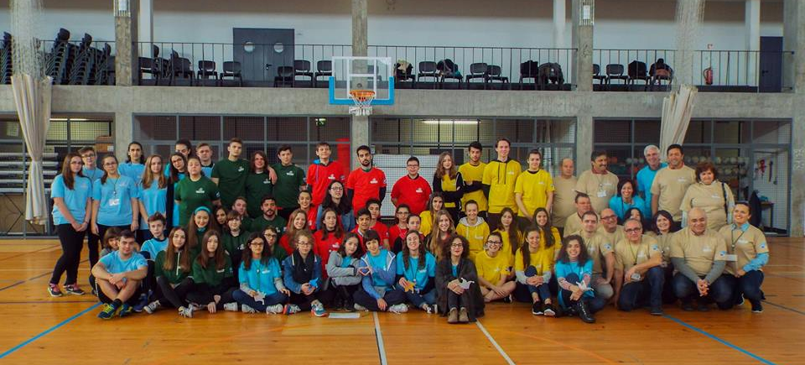
Portugal - Sports to stop violence
Games without Borders Competition – Mixed teams played adaptive sports usually played by persons with a disability (physical/intellectual)

Slide 6
Adaptive sports:
Goalball (blind)
Boccia
Seated volleyball
Athletics for the blind

Slide 7
Slovenia Arts and Crafts to stop violence
Art workshop - students working together with day centre for the disabled users
– screen printing on T-shirts
- tile painting using traditional patterns

Slide 8
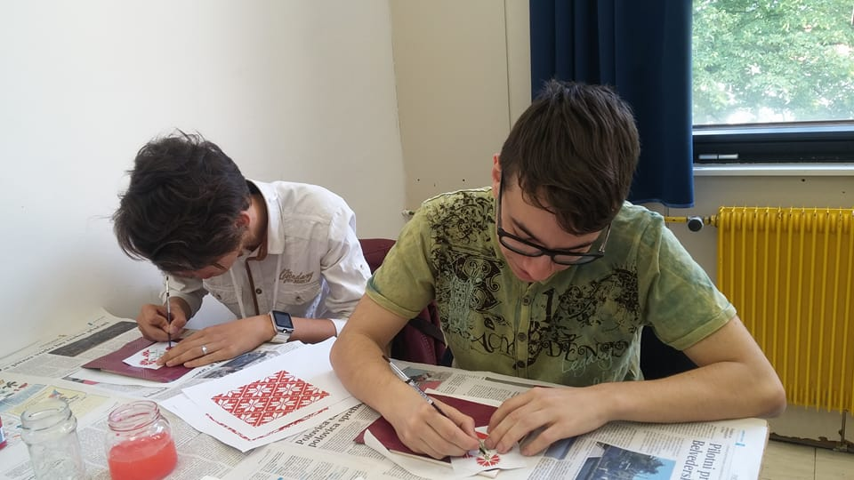

Slide 9
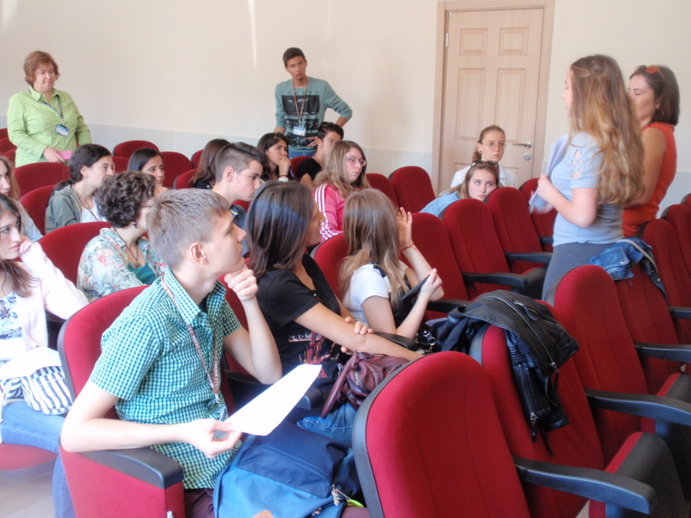
Turkey
Photographs & Films to stop violence
Research on celebrities who had been bullied in early ages
Brainstorming & Group work
Shooting the film
Watching & Discussion
Preparing the slogans

Slide 11
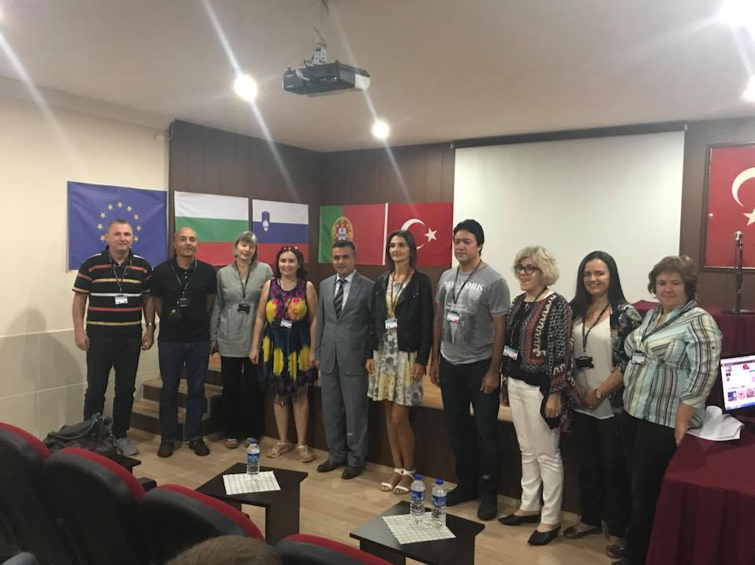

Slide 12
Bulgaria
Music & Dance to stop violence

Slide 14
Goals of the seminar
What are the approaches to overcoming bullying?
What can be done at school and the teacher with his class?
How to cause stable change in the behavior of the abuser?

