Slide 1
Workshop „Good practices for better communication between children and parents”
13.10.2016. Jelgavas 6. vidusskola
school psychologist Jeļena Votčele

Slide 2
Some conclusions from theory
Communication is the process of establishing, maintaining and developing contacts, whose goal is to influence the behavior of the partner; it is the form in which people satisfy their social needs.
Good parent/child communication – good parenting.
A parent's relationship with his or her child will be reflected in the child's actions – including child behavior problems.
Listening and talking is the key to a healthy connection between parents and their children.

Slide 3
Laurence Steinberg The Ten Basic Principles of Good Parenting
What you do matters.
You cannot be too loving.
Be involved in your child's life.
Adapt your parenting to fit your child.
Establish and set rules.
Foster your child's independence.
Be consistent.
Avoid harsh discipline.
Explain your rules and decisions.
Treat your child with respect.

Slide 4
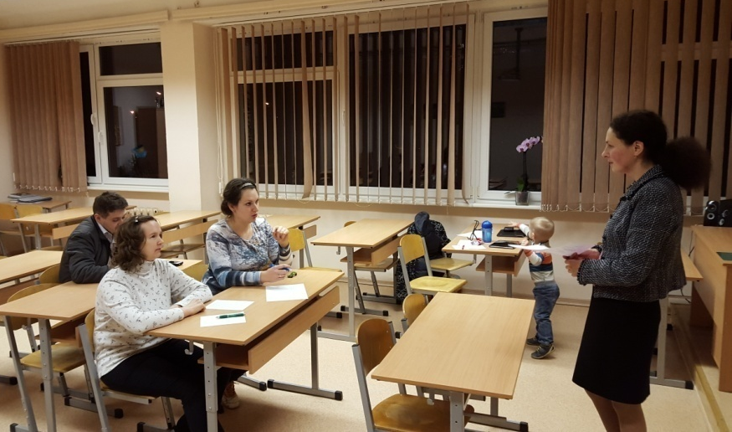
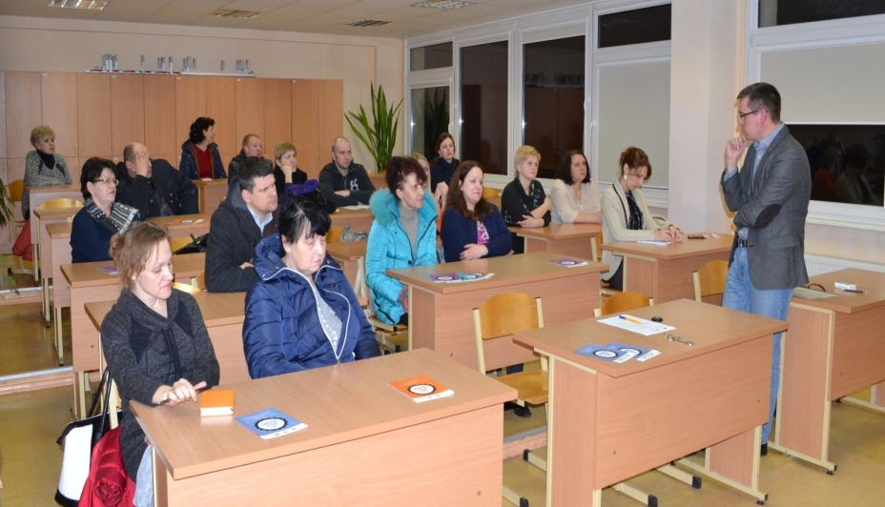
Good practices for better communication between children and parents in Jelgavas 6. vidusskola
Individual consultations for parents and their children about effective parenting (psychologist)
Educational and supporting groups and workshops for parents:
by the school psychologist
by invited experts

Slide 5
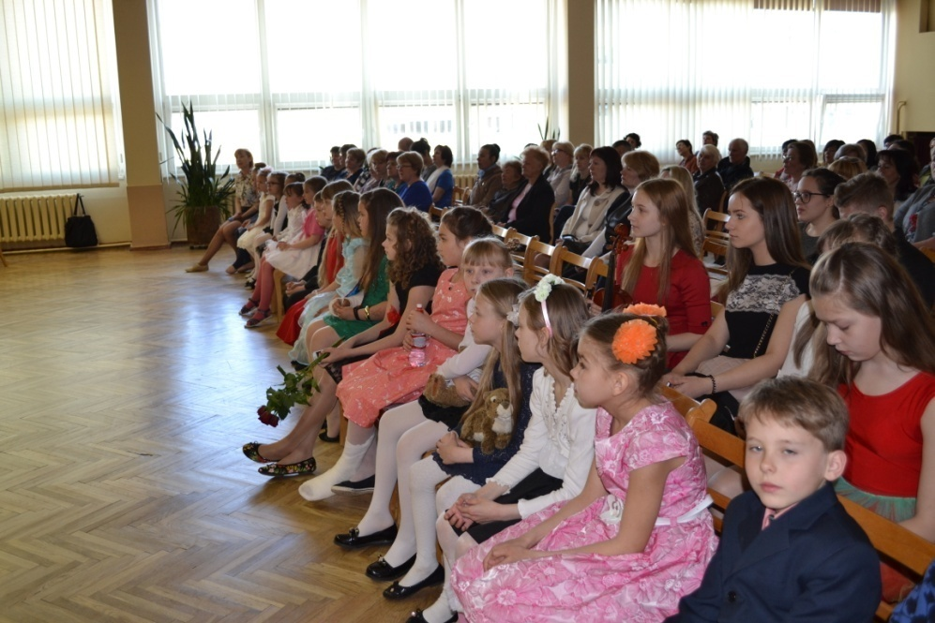
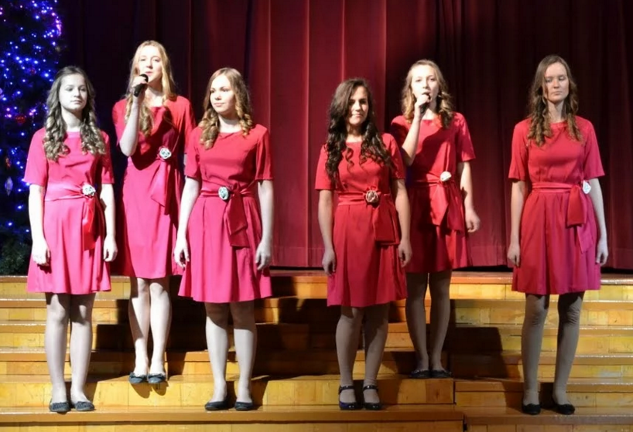
Exhibitions and concerts with and for parents

Slide 6
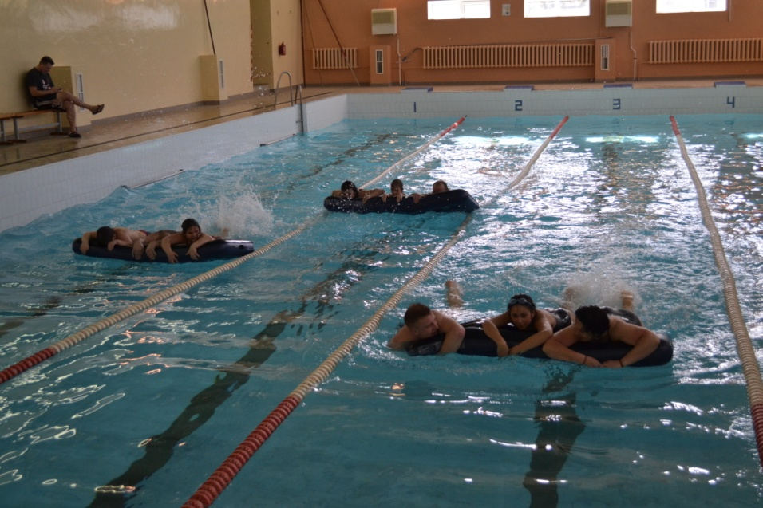
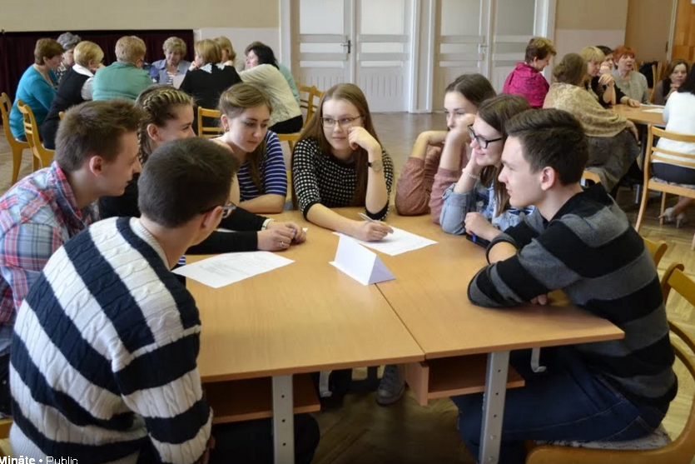
Discussions
Sport activities

Slide 7
Inquiry of children and their parents
Children from
5th Form (11 years old) – 24 pupils
7th Form (13 years old) – 25 pupils
11-12 Forms (17-18 years old) – 54 pupils
Parents:
5th Form – 13 people
7th Form – 7 people
11-12 Forms – 16 people

Slide 8
What is “a good parent” for children? (pupils, %)

Slide 9
When do the parents think they are “good parents”? (parents, %)

Slide 10
In the relationship between children and parents the most important are:
%

Slide 11
What do children appreciate in their communication with parents most of all?
understanding
trust
love
attention
talk
advice
honesty
justice
care
respect
kindness
support
interest in their life
spending time together

