Slide 1
Jelgavas 6. vidusskola
Relationships between students and their parents
11.a class students
Balobina Jūlija
Petruks Maksims
Albiņa-Alba Evija
Basalajs Vladislavs
Vedļa Kirils
Jelgava 2016

Slide 2
Questions:
Which tips do help us to develop a positive relationship with our families?
What does a positive relationship with our parents mean to us?
Which character traits do we admire in our parents?
Why are parents always there for us?

Slide 3
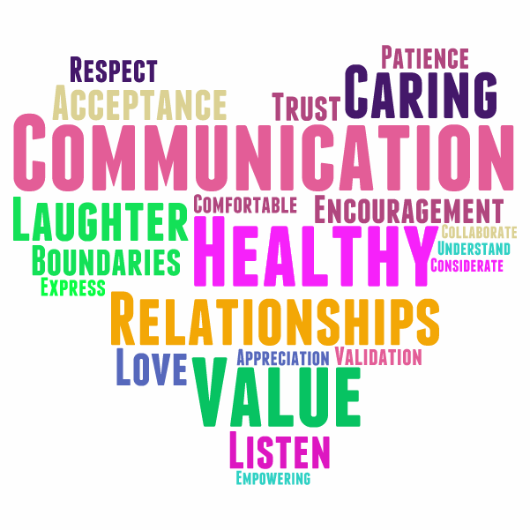
Which tips helped us develop a positive relationship with our families
Communicating Often and in Various Forms
Listening to Parents
Letting Parents Know How They Can Help
Thanking Parents
Sharing Every Success
Inviting Parents to Participate in Making Some Decisions
Being Honest

Slide 4
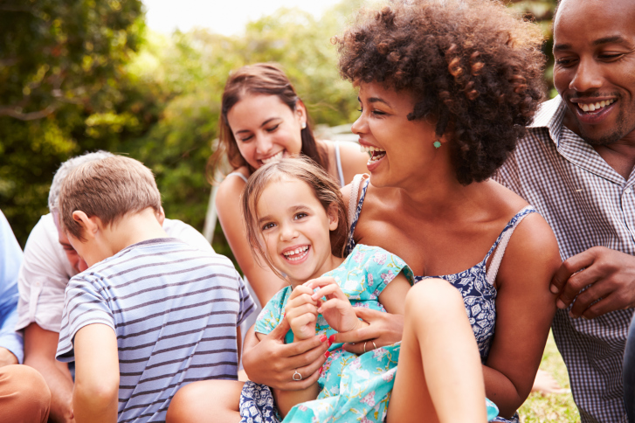
What does a positive relationship with our parents mean to us?
Support system (source of care and emotional support)
Voice of reason in a critical situation
Reason to become a better person

Slide 5
Which character traits do we admire in our parents
Patience
Honesty
Compassion
Kindness to self and others
A sense of curiosity and wonder
Respect
Leading and following
Optimism and positivity
Ability to listen

Slide 6
Why are parents always there for us?
All the things that they are teaching are told to us to make us a better person.
Parents always try to teach us things to help us, to get us through tough times and to prepare us for adult life.

Slide 7
Jelgavas 6. vidusskola
Relationships between students and their parents
11.a klases skolnieki
Balobina Jūlija
Petruks Maksims
Albiņa-Alba Evija
Basalajs Vladislavs
Vedļa Kirils
Jelgava 2016

